Slide 1
Movement and Polish

Slide 2
Easing Functions (aka tweening)

Slide 3
Easing Functions were developed by Robert Panner
It grew in popularity, until it is found in many front-end related fields due to how flexible it is
Commonly used to do simple animations through code.

Slide 4
Easing Functions describe the rate of change of a parameter over time.
The parameters you want to affect are up to you to choose:
Position
Size
Color
…almost anything, really!

Slide 5
“Given a start value S, an end value E,
a percentage P that represents the completeness between S and E,
what is the value at P?

Slide 6
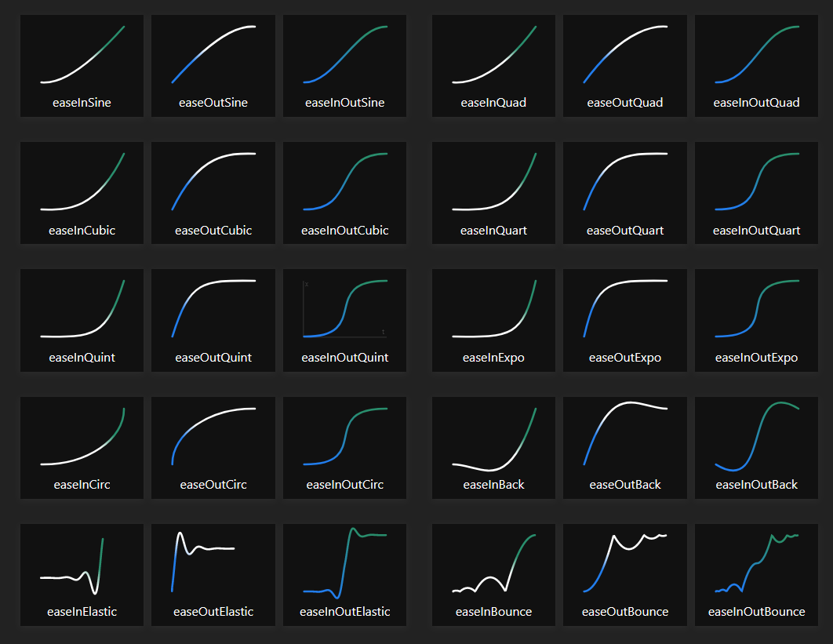

Slide 7


Slide 8
Let’s start with the simplest of
Easing Functions
Linear
(also known as Lerp)

Slide 9
A parameter put into a Linear Easing Function has a constant rate of change over time.

Slide 10
This means that they don’t accelerate or decelerate at any point

Slide 11
Thank you for your time ☺

Slide 12
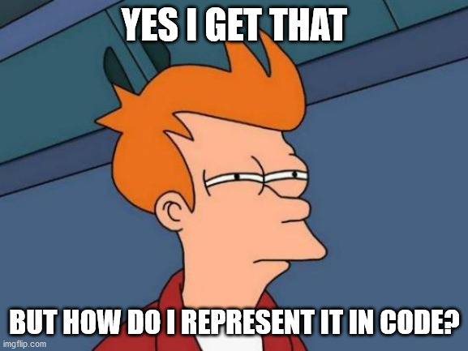

Slide 13
Recall that we are given:
A start value S
An end value E
A percentage value P

Slide 14
When P is 0%, we return S.
When P is 100%, we return E.
When P is 50%?
When P is 25%?

Slide 15
Perhaps numbers help
If S is 0, E is 100, P is 50%, result is ___.
If S is -20, E is 0, P is 10%, result is ___.
If S is 100, E is 0, P is 90%, result is ___.

Slide 16
Perhaps numbers help
If S is 0, E is 100, P is 50%, result is 50.
If S is -20, E is 0, P is 10%, result is -18.
If S is 100, E is 0, P is 90%, result is 10.
But how would you write such a function?

Slide 17
Perhaps numbers help
If S is 0, E is 100, P is 50%, result is 50.
If S is -20, E is 0, P is 10%, result is -18.
If S is 100, E is 0, P is 90%, result is 10.
But how would you write such a function?
(1.0 – P) * S + P * E

Slide 18

Perhaps numbers help
If S is 0, E is 100, P is 50%, result is 50.
If S is -20, E is 0, P is 10%, result is -18.
If S is 100, E is 0, P is 90%, result is 10.
But how would you write such a function?
(1.0 – P) * S + P * E

Slide 19
The rest of the easing functions pretty much follow the same function prototype.

Slide 20
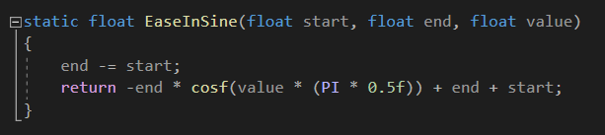
Ease In

Slide 21
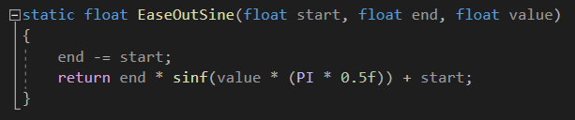
Ease Out

Slide 22
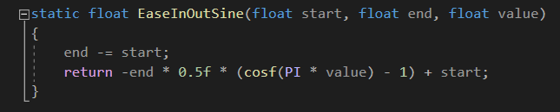
Ease In/Out

Slide 23


Slide 24
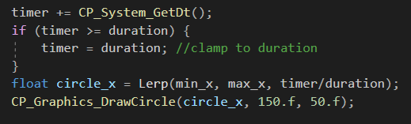
It’s up to you!
But a common way to have a float that represents time that increases over the intended duration of the animation as P!

Slide 25
DEMO!

Slide 26
Movement with acceleration

Slide 27
Before we talk about acceleration, we need to talk about velocity.
So what is velocity?

Slide 28

Velocity is a vector that represents the rate of change of position over time.

Slide 29

Acceleration is a vector that represents the rate of change of velocity over time.

Slide 30
DEMO!

Slide 31
BONUS: Damping (the cheap hacky way)

Slide 32
Damping is used as part of physics systems to emulate spring-like effects when it comes to one object chasing another.

Slide 33
It will cause a chasing object to move faster when it’s further away from its target and slower when it’s nearer.
This creates a nice smooth spring-like acceleration/deceleration

Slide 34
This is useful for systems like chasing cameras, particles, and anything that requires some kind of ‘spring-like’ effect.

Slide 35
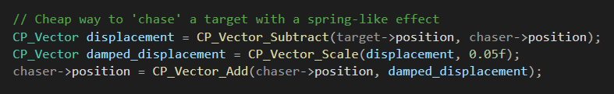

Slide 36
DEMO!

